Slide 1



Data Management and Database Design
POLARIS
BAGGAGE AND CATERING MANAGEMENT SYSTEM (BCMS)

Slide 2
AGENDA
Introduction
Data Requirements Phase
Project Management Strategies
Conceptual Data Modeling
Logical Database Design
Physical Database Design
Business Rules
System Implementation
Conclusion and Q&A Session

Slide 3



EXECUTIVE SUMMARY
Objective: To design a robust database for efficiently managing airport baggage tracking and catering services.
Tools & Techniques:
ERD Development using Lucidchart.
Logical and Physical Database Design using MySQL.
Normalization to ensure integrity and efficiency.
Deliverables:
Comprehensive schema supporting real-time baggage and catering operations.

Slide 4
DATA REQUIREMENTS AND COLLECTION PHASE
Data Evaluated
Passenger details, flight schedules, baggage logs, meal preferences, and inventory data.
Identified Gaps
Key Outputs
Lack of real-time baggage status updates.
Absence of dynamic meal inventory reports.
Real-time baggage tracking and damage reports.
Dynamic meal inventory summaries.
Stakeholder Input:
We collected data from airport staff, airline personnel, and catering vendors to identify critical data points.

Slide 5




PROJECT MANAGEMENT STRATEGIES
PHASE 1: ERD DEVELOPMENT
STEP 1: DEFINE ENTITIES AND RELATIONSHIPS.
STEP 2: CREATE ERD IN LUCIDCHART.
STEP 3: VERIFY ALIGNMENT WITH REAL-WORLD PROCESSES.
Outcome: The ERD accurately represents all business operations, laying the foundation for logical and physical database design.
PHASE 2: (DESIGN AND IMPLEMENTATION)
Step 1: Logical database design.
Step 2: Normalize tables.
Step 3: Implement physical database using MySQL.
Outcome: Scalable, efficient database for operations.

Slide 6
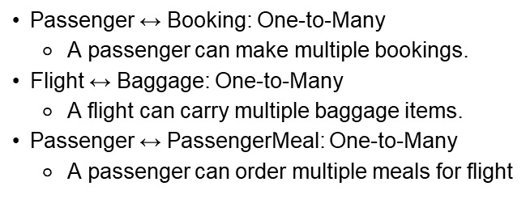
Entities Identified
Key Relationships
Passenger
Booking
Flight
Baggage
Meal
MealInventory
InFlightSales
Payment
Airport
PassengerMeal
Vendor
BaggageTracking
BaggageFee
ClassPolicy
BaggagePolicy
Normalization
Reduce redundancy and ensure data integrity.

Slide 7
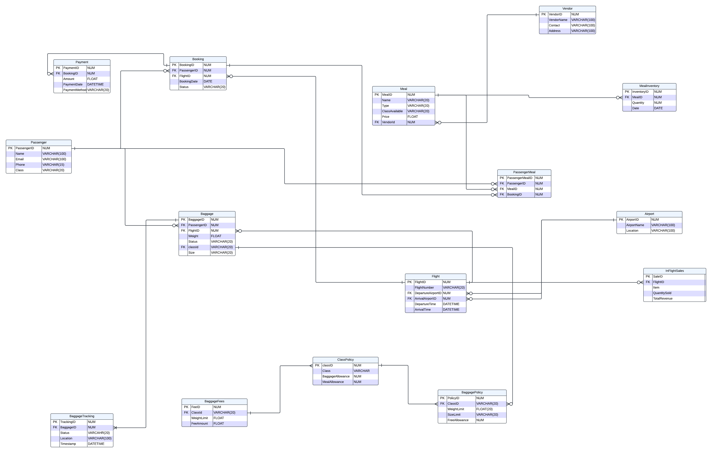
CONCEPTUAL DATA MODELING (ERD OVERVIEW)

Slide 8
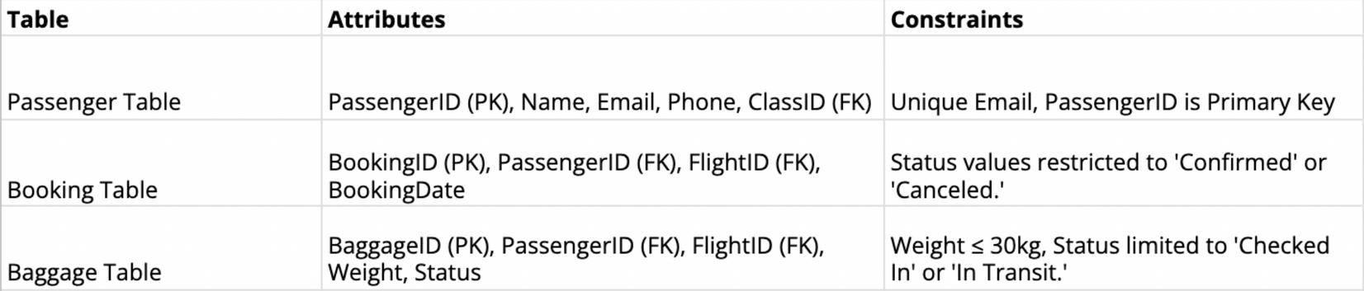
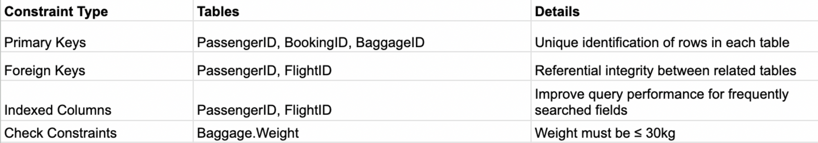
LOGICAL DATABASE DESIGN – CONSTRAINTS AND INDEXING
Key Tables and Attributes
Indexing Examples:

Slide 9
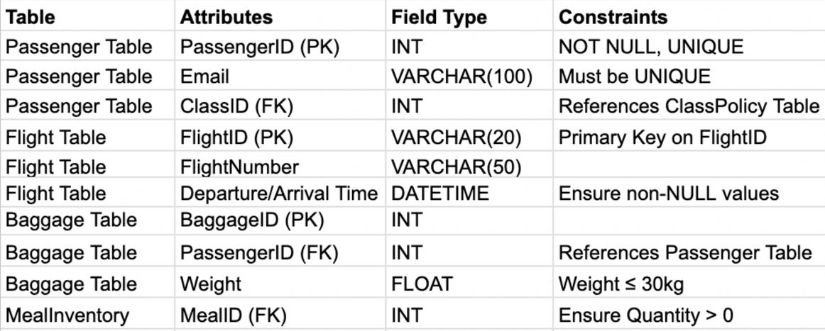
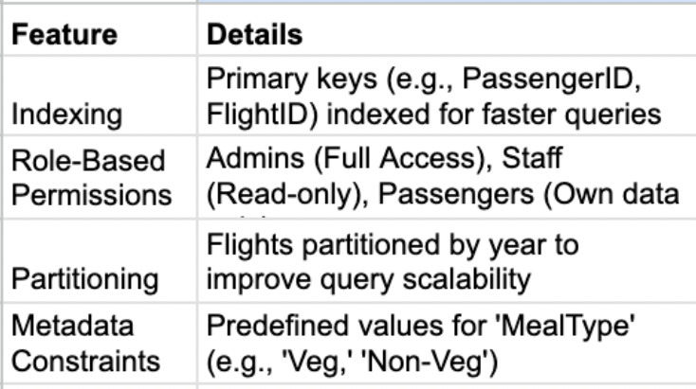
PHYSICAL DATABASE DESIGN
Field Types and Constraints:
Optimization and Access Control:

Slide 10

BUSINESS RULES
Business Rule: Valid Payment Methods
Description: The payment method used by passengers for transactions must be one of the predefined acceptable methods: Credit Card, Debit Card, or PayPal.
Rule Name: Maximum Baggage
Weight Limit Description: The weight of a baggage item must not exceed 30 Kg.
Business Rule: Valid Baggage
Status Description: Baggage status must always be one of the predefined states: Checked In, In Transit, Loaded on Flight, or Delivered.
PaymentMethod VARCHAR2(50) NOT NULL CHECK (PaymentMethod IN ('Credit Card', 'Debit Card', 'PayPal’)),
Status VARCHAR2(20) NOT NULL CHECK (Status IN ('Checked In', 'In Transit', 'Loaded on Flight', 'Delivered’)),
Weight NUMBER NOT NULL CHECK (Weight <= 30)

Slide 11
BUSINESS RULES
Rule Name: Meal Type
Restriction Description: The type of meal provided must be either "Veg" or "Non-Veg.
Passenger Count per Flight
The total number of passengers per flight must be monitored for operational planning.
Type VARCHAR2(20) NOT NULL CHECK (Type IN ('Veg', 'Non-Veg’)) SELECT F.FlightID, F.FlightNumber, COUNT(FP.PassengerID) AS TotalPassengers
FROM Flight F LEFT JOIN FlightPassenger FP ON F.FlightID = FP.FlightID
GROUP BY F.FlightID, F.FlightNumber ORDER BY F.FlightID;

Slide 12
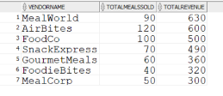
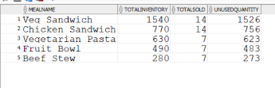
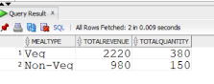
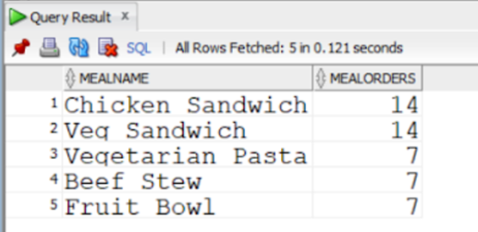
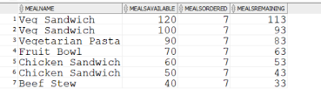
QUERY-BASED ANALYSIS FOR STRATEGIC BUSINESS PLANNING
Top Performing Vendors.
Unutilized Meals: Find meals that are Under-utilized
Profitability by Meal Type: Compare the profitability of vegetarian and non-vegetarian meals.
Popular Meals Based on Passenger Preferences
Catering Inventory Status: Check the current status of the catering inventory

Slide 13
SYSTEM IMPLEMENTATION
Use Cases:
Real-time data tracking across multiple airport operations
Scalable database architecture
Integrated passenger, baggage, and catering management
Operational Benefits:
Enhanced operational efficiency
Reduced manual tracking errors
Improved passenger experience
Dynamic resource allocation
.

Slide 14
Thank you
Conclusion
Successfully designed an efficient database system for catering and baggage operations.
Future Implementations
Incorporate predictive analytics for demand forecasting.
Explore advanced indexing techniques for performance optimization.
Enable integration with IoT devices for real-time data updates.
Q&A
Thank you for your attention!
Please feel free to ask any questions.

